Slide 1

DELUR RETURN ANALYSIS
By CHIDIMMA IDIKA

Slide 2
OVERVIEW
Delur Services is a customer-centric company that provides a wide range of products to customers across different states. With a dedicated team of Customer Support Agents, they ensure that every customer interaction is handled with utmost care and efficiency. They take pride in delivering products on time and ensuring a seamless delivery performance to meet customers' expectations.
Delur Services is committed to maintaining a high level of customer satisfaction by carefully tracking customer feedback, and the focus on continuous improvement allows service enhancement based on valuable insights received from customers, providing an exceptional customer experience.

Slide 3



PROBLEM STATEMENT
Delur Services, a customer-centric company offering a diverse range of products to customers across various states, has identified discrepancies in their return rate. The company aims to achieve a target return rate of 5% for the upcoming year.
To address this issue and enhance their customer experience, Delur Services seeks to gain a comprehensive understanding of their data related to customer interactions, product deliveries, and return rates.
The company requires actionable insights and recommendations based on data analysis to improve their return rate and achieve their target.

Slide 4
OBJECTIVES
Data Collection & Preparation
Collect, clean and organize the data to ensure accuracy & consistency.
Return Rate Analysis
Calculate current return rate for different customer segments. Identify patterns & trends in return rates.
Root Cause Identification
Investigate the underlying factors contributing to the higher-than-desired return rate. Analyze customer feedback, delivery performance, product quality & customer support interactions.
Segmentation & Customer Insights
Segment customers based on demographics, purchase history, and interaction behavior. Understand which customer segments contribute more to the return rate and tailor strategies to address specific segments' concerns.
Delivery Performance Evaluation
Assess the efficiency of the delivery process. Identify any correlations between delivery performance and return rates.
Recommendations for Improvement
Provide actionable recommendations to reduce the return rate & enhance customer satisfaction. Suggest strategies to address identified root causes.

Slide 5
DATA DICTIONARY
1. Date: The date when the transaction or event occurred. | 7. Quantity: The number of units of the product purchased in the transaction.
2. Customer Acquisition Type: This feature indicates how the customer was acquired or the marketing channel through which they became a customer. | 8. Cost: The undiscounted cost of the goods involved.
3. Customer Support Agent: The name or identifier of the customer support agent who handled the interaction with the customer. | 9. Discount: Any discount applied to the total price or individual product price in the transaction.
4. State: The state or region where the customer is located or where the transaction took place. | 10. Delivery Performance: This feature measures the efficiency and timeliness of the delivery process.
5. Product: The name or identifier of the product that the customer purchased. | 11. Return: A binary flag or indicator representing whether the customer returned the product after purchase.
6. Unit Price: The individual price of one unit of the product. | 12. Customer Satisfaction: A categorical rating representing the level of satisfaction expressed by the customer after the interaction or purchase.

Slide 6
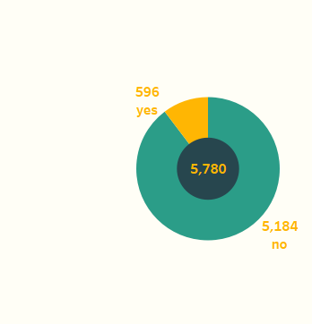
INSIGHTS
Over the years 2017, 2018, and 2019, Delur Services had a total cost of $8,586K, with 5,780 total orders and 31,732 units ordered.
The average discount across all years was 11%.
Return Rate
The return rate for all years combined was 10.3%, with 596 orders returned out of 5,780 total orders.
The yearly return rates were 10.7% in 2017, 8.9% in 2018, and 11.4% in 2019.
KPI’s
Return Rate

Slide 7
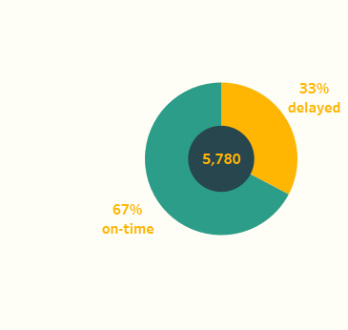
INSIGHTS
Delivery Performance
The overall on-time delivery rate was 67%, while delayed deliveries accounted for 33%.
On-time delivery percentages for individual years were 2017: 67%, 2018: 66%, and 2019: 69%.
Delivery Performance

Slide 8
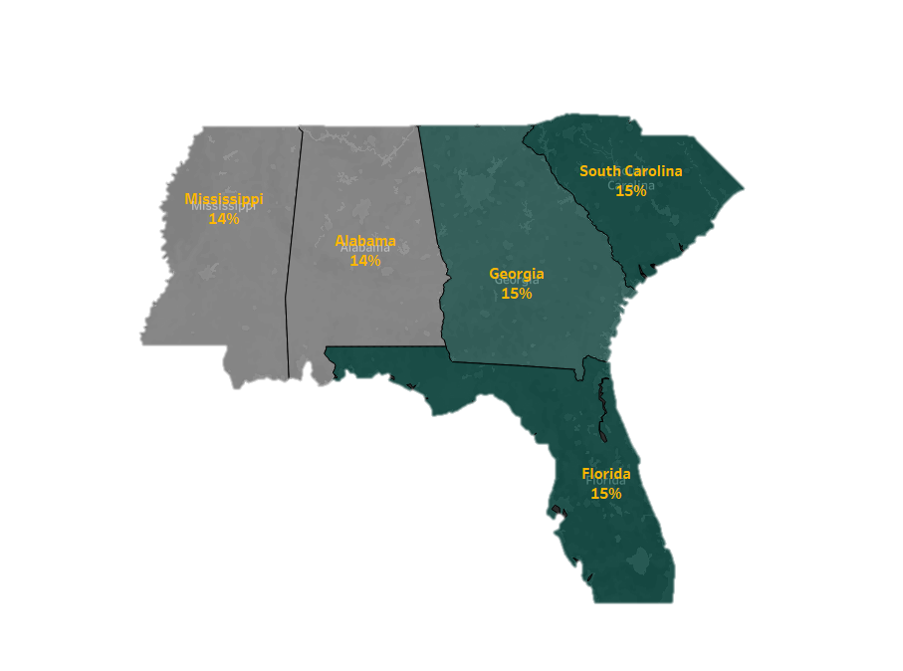
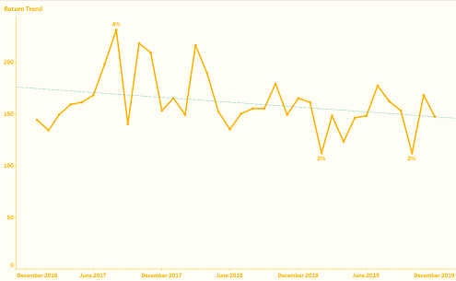
INSIGHTS
Returns per Support Agent
Among support agents, return rates were consistent over all years, with values ranging from 11% to 14%.
Return by State
Return rates by state remained relatively stable across all years, varying between 14% and 15%.
Return Trend
The overall return trend exhibited a slight decline over the analyzed years, with the highest return rate of 4% in August 2017 and the lowest of 2% in February 2019.

Slide 9
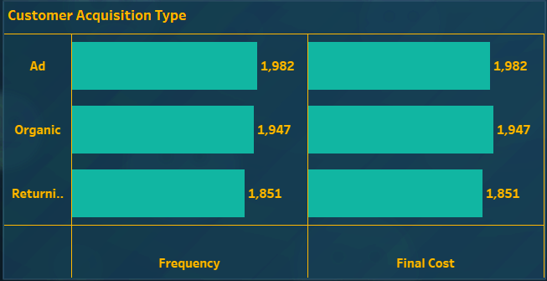
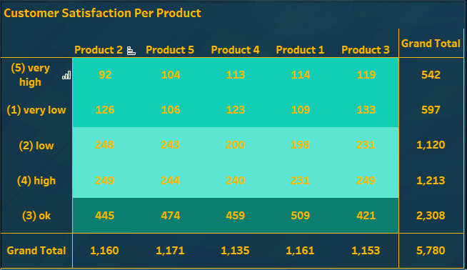
INSIGHTS
Customer Acquisition Type
Across all years, the customer acquisition channels (Ad, Organic, Returning) had similar frequencies, each contributing to around 30-35% of total orders.
Customer Satisfaction
Customer satisfaction levels varied across years, with most customers falling into the "OK" category (around 40%), followed by "High" and "Low" satisfaction levels.

Slide 10
CONCLUSION
Delur Services has achieved relatively consistent return rates over the years, with some fluctuations.
Delivery performance has shown a slight improvement, with a higher on-time delivery rate in 2019 compared to previous years.
Support agent return rates remain steady, highlighting the importance of continuous training and support.
Return rates by state have remained relatively stable, indicating consistent customer behavior across regions.
The return trend indicates certain months with higher returns, which could be due to specific seasonal factors.
Customer acquisition channels play a similar role in bringing orders to the company.
Customer satisfaction is balanced across various levels, indicating room for improvement in the "Low" and "Very Low" satisfaction segments.

Slide 11
RECOMMENDATIONS
1. Return Rate Management
Focus on products with higher return rates; improve their quality and provide clearer usage instructions to reduce returns.
Implement a comprehensive return policy that addresses customer concerns while maintaining company profitability.
2. Delivery Performance Enhancement
Continue to prioritize on-time deliveries, which positively correlate with lower return rates.
Optimize logistics and communication with delivery teams to ensure timely and accurate deliveries.
3. Support Agent Training
Provide targeted training to support agents with higher return rates, emphasizing effective issue resolution and customer communication skills.
4. Regional Strategies
Investigate reasons for higher return rates in states like South Carolina, Georgia, and Florida; tailor solutions based on regional customer behavior.
5. Seasonal Return Trend
Align marketing and inventory management strategies to anticipate and address the seasonal peak in returns during certain months.

Slide 12
RECOMMENDATIONS
6. Customer Acquisition Channels
Allocate resources based on the effectiveness of customer acquisition channels, focusing on optimizing the ROI of advertising efforts.
7. Customer Satisfaction Enhancement
Devote efforts to improve "Low" and "Very Low" satisfaction segments, addressing their concerns to reduce returns and enhance loyalty.
8. Long-term Strategy
Develop a sustainable strategy to maintain a 5% or lower return rate, leveraging ongoing data analysis and customer feedback.
9. Cross-functional Collaboration
Foster collaboration between support agents, delivery teams, and management to holistically address return-related challenges.
10. Performance Monitoring
Establish a system to monitor the progress of return rate improvements and adapt strategies based on evolving trends.

Slide 13
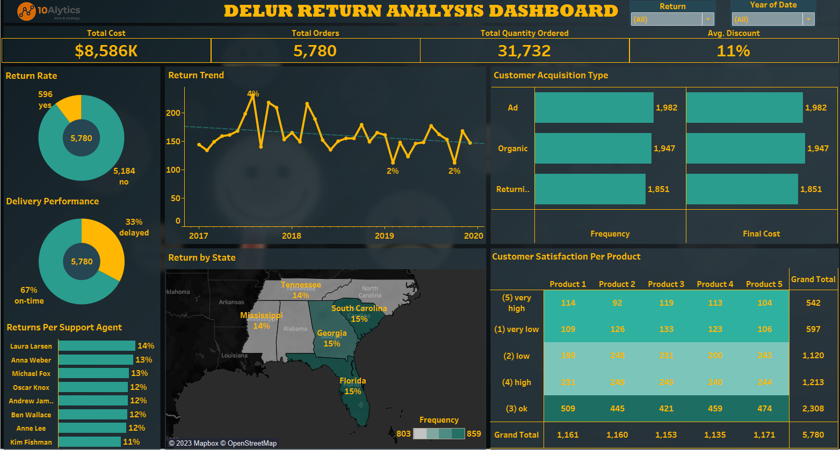
DASHBOARD

Slide 14
THANK YOU!

